Slide 1
Evidence Based Delphi Engineering: How to ignore “best practices” and so called “experts.”
Jim McKeeth
jim@gdksoftware.com
gdksoftware.com
How you Know you are Writing the RIGHT code

Slide 2
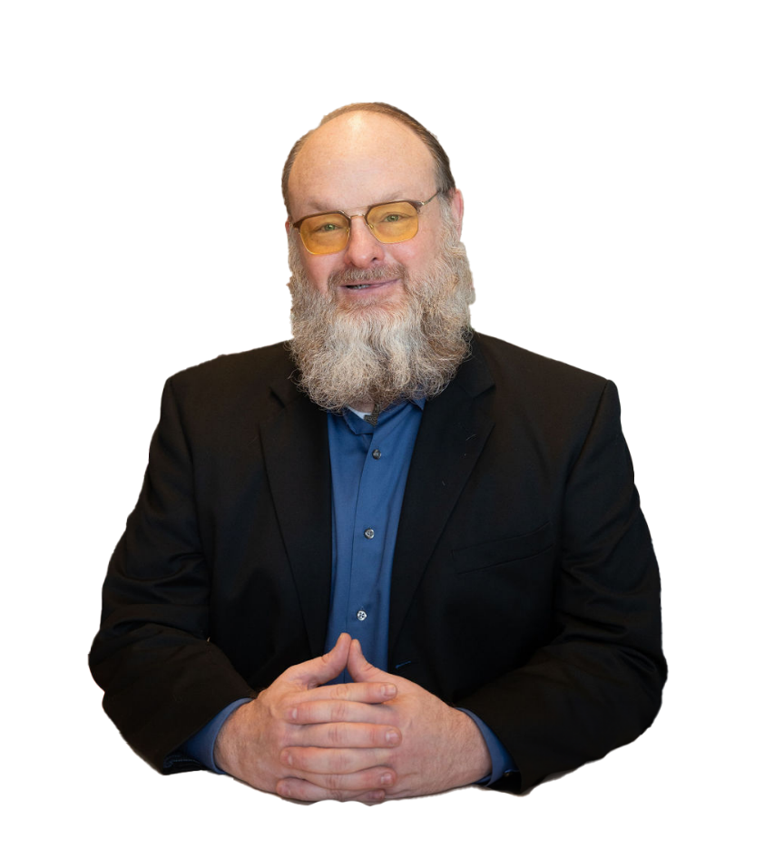
About Jim McKeeth
Director of GDK Software, USA & Delphi MVP
Previously Embarcadero Chief Dev Advocate
Over 30 years experience in software development
Worked professionally in many languages and platforms, including Delphi, C#, C/C++, Java, JavaScript, and Python
Multiple technology patents & book contributions
Spoken on software development all around the world
Professional improv comedy performer for 10 years

Slide 3
BEGIN

Slide 4
INTERFACE
This is a work in progress and will continue to evolve over time.
Premise
What is software engineering?
Finding the Evidence
Understanding Runtime: Big O
Premature Optimization
Use the source
In the IDE
External Tools
More Resources
github.com/jimmckeeth/ Evidence-Based-Software-Engineering

Slide 5

Why do you write the CODE you write?

Slide 6
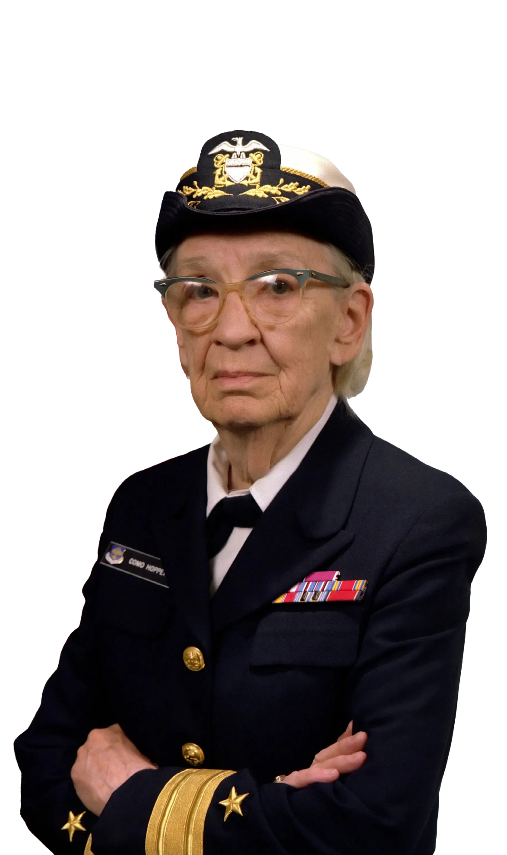
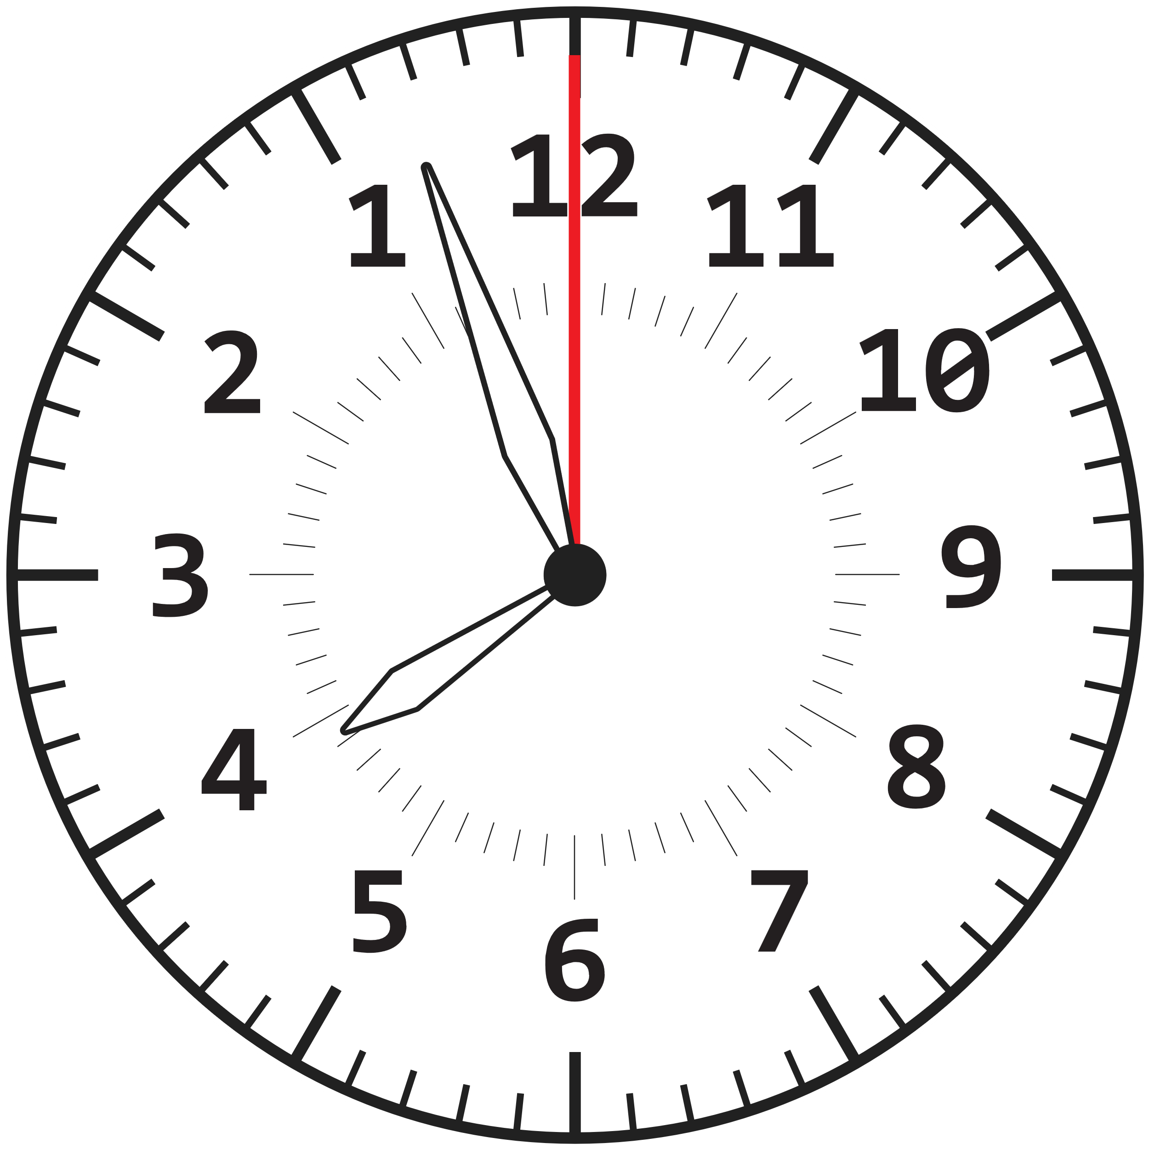
Grace Hopper, RDML
Wrote first computer manual
Machine-independent programming languages
FLOW-MATIC & COBOL
Carried around light nanoseconds
29.97 cm of wire
The most dangerous phrase, “We've always done it this way.”
https://en.wikipedia.org/wiki/Grace_Hopper

Slide 7
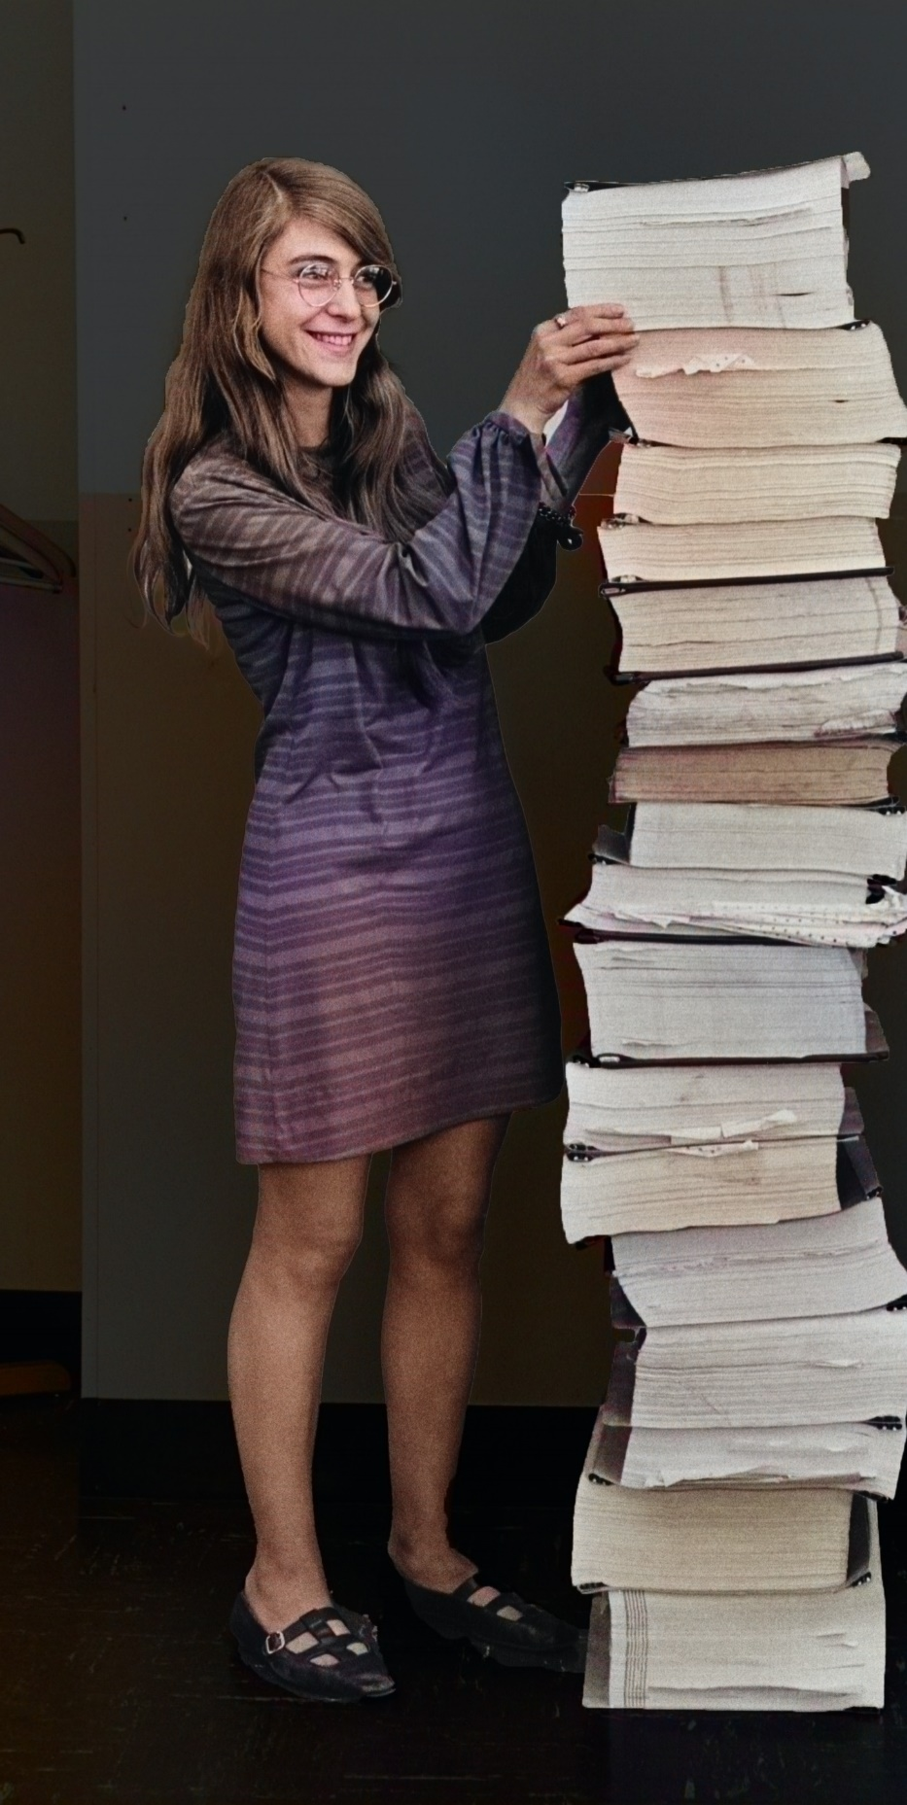
Margaret Hamilton
Director of the Software Engineering Division of the MIT Instrumentation Laboratory
Developed flight software for the Apollo program
2016 – Presidential Medal of Freedom from Obama
Published over 130 papers
Invented the term “software engineering”
“…to distinguish it from hardware and other kinds of engineering, yet … as part of the overall systems engineering process.”
https://en.wikipedia.org/wiki/Margaret_Hamilton_(software_engineer)

Slide 8

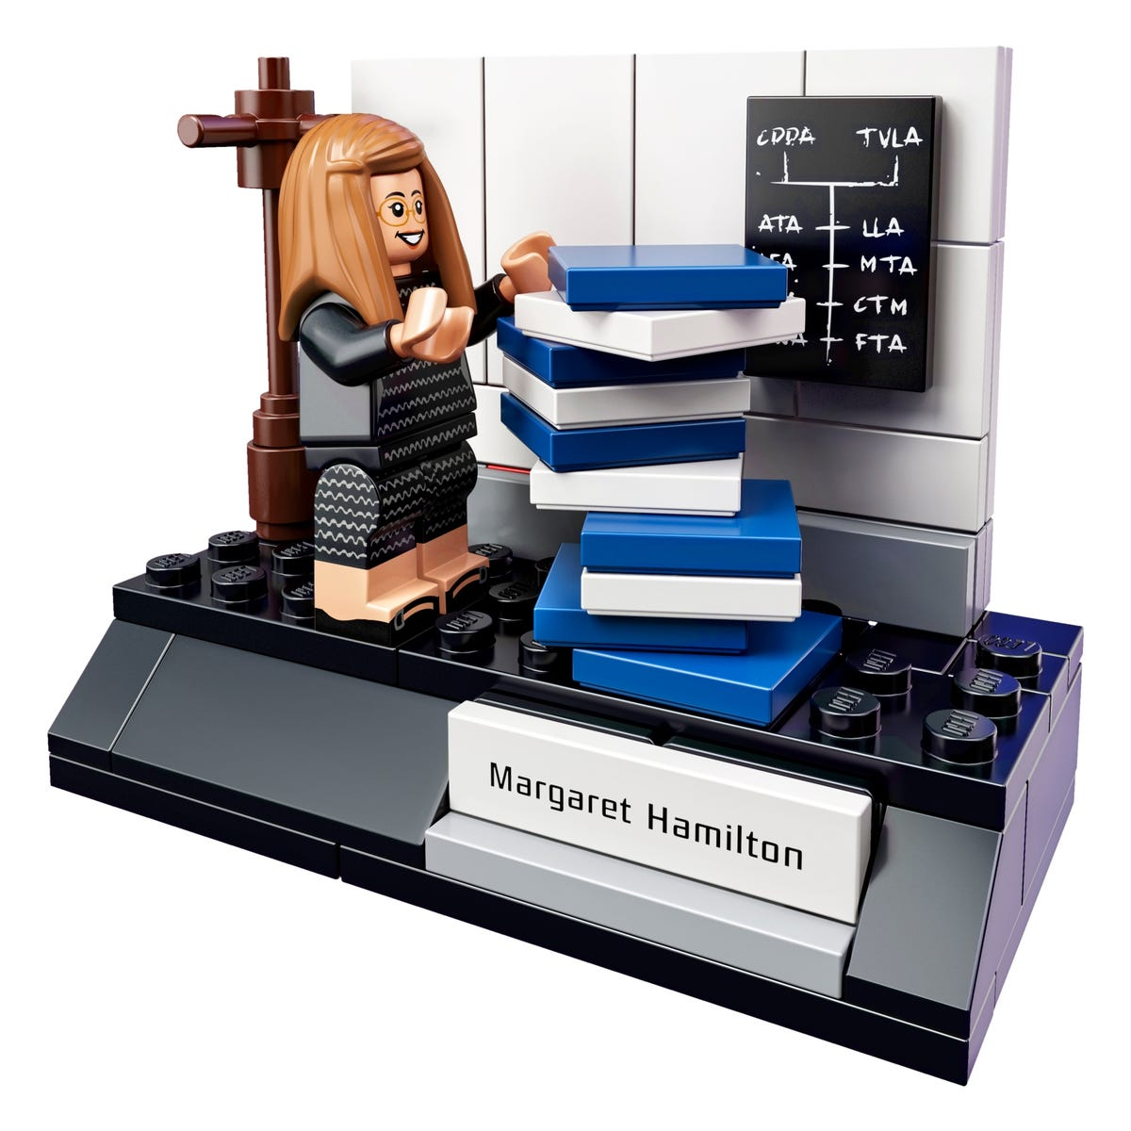
Women of NASA
LEGO Set # 21312

Slide 9
IMPLEMENTATION

Slide 10

Don't believe anything I tell you!

Slide 11
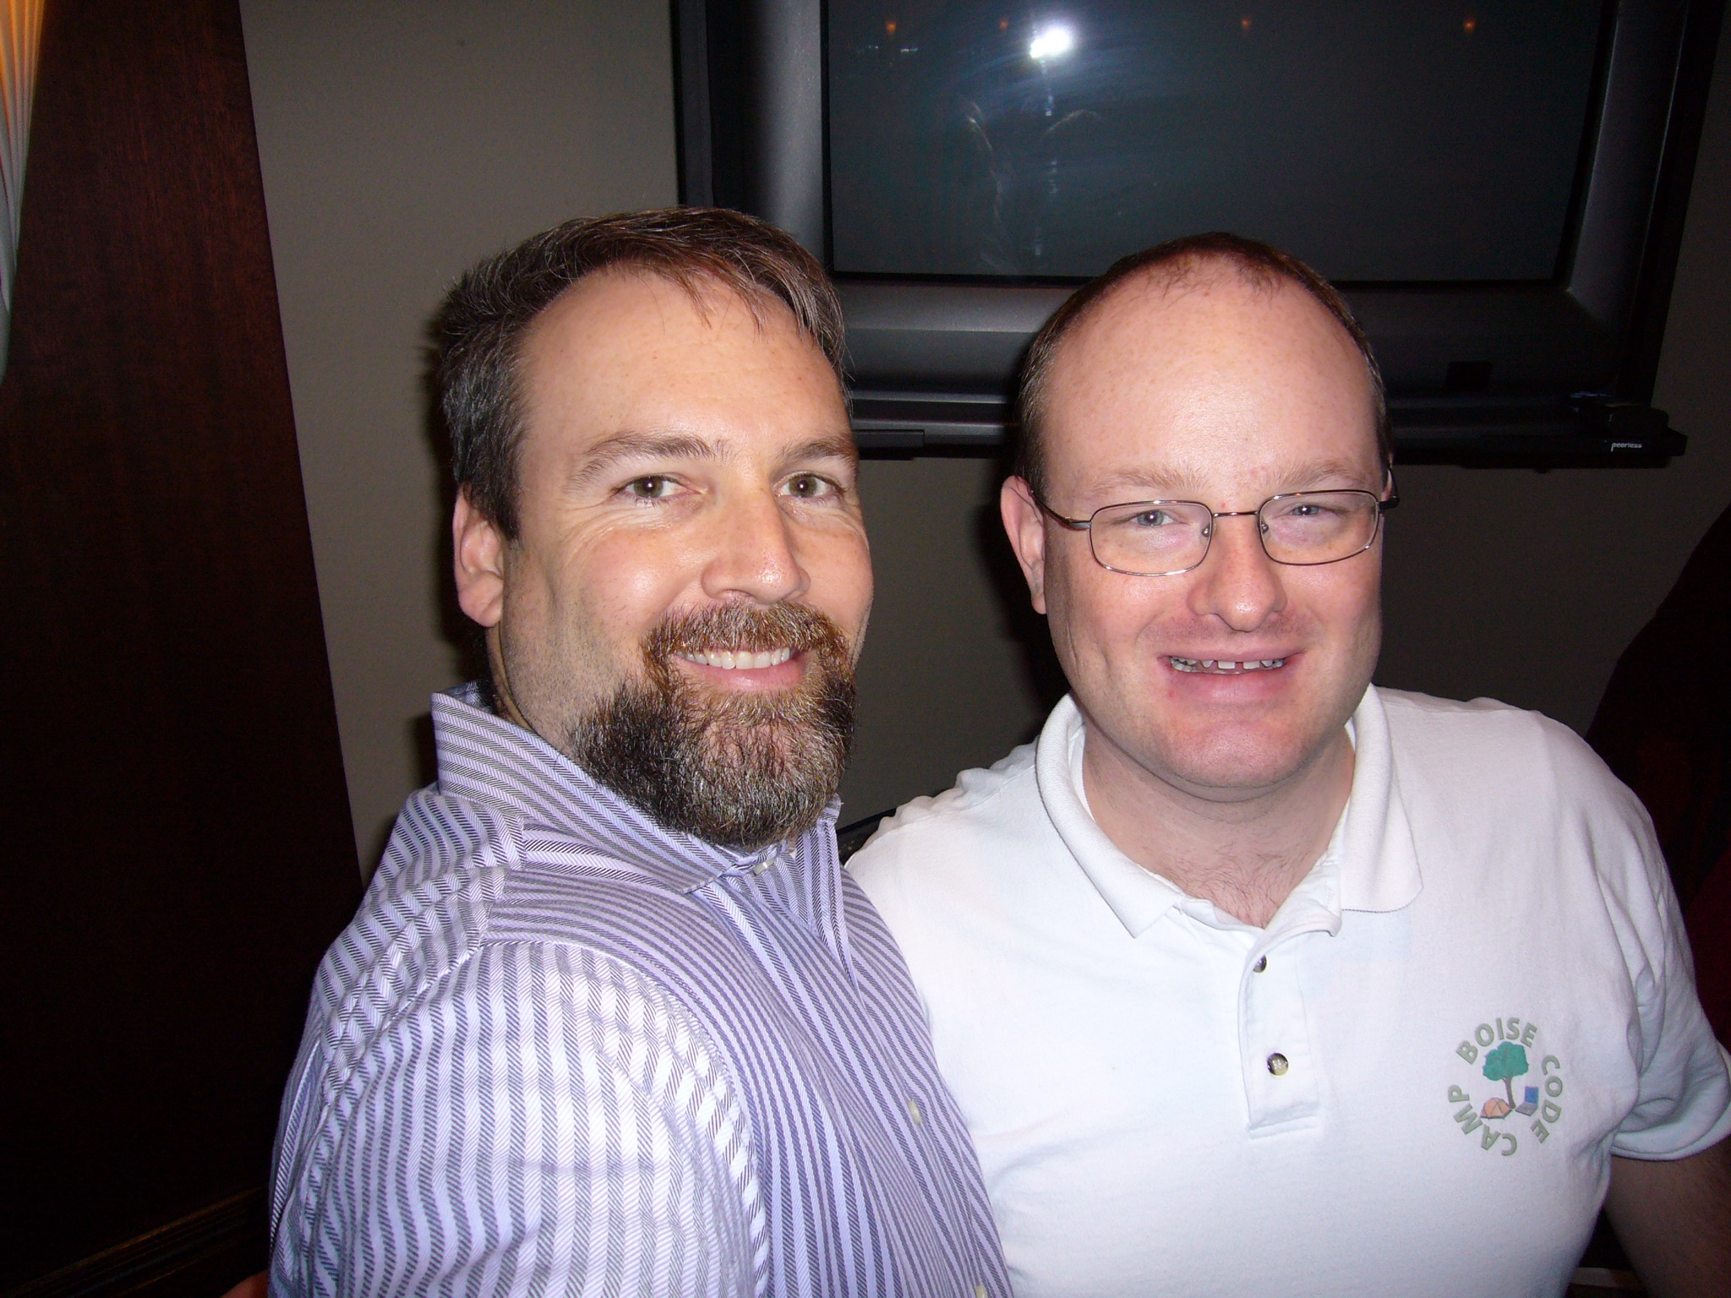
Travel back
In
time…
Circa 2007

Slide 12
Consider this Code
Justification…
The try/except guarantees the code after the end is executed…
Raise allows the exception handler further up the stack to handle it…
Unfortunately…
Raise in the except prevents the code after the end from running when an exception occurs….
The exception code path was never tested, so this pattern was wide spread in production and multiple projects.
sl := TStringList.Create;
try
// use TStringList
except
raise;
end;
sl.free;
The developer read this in a book and accepted it as truth, never questioning the way he used it…

Slide 13
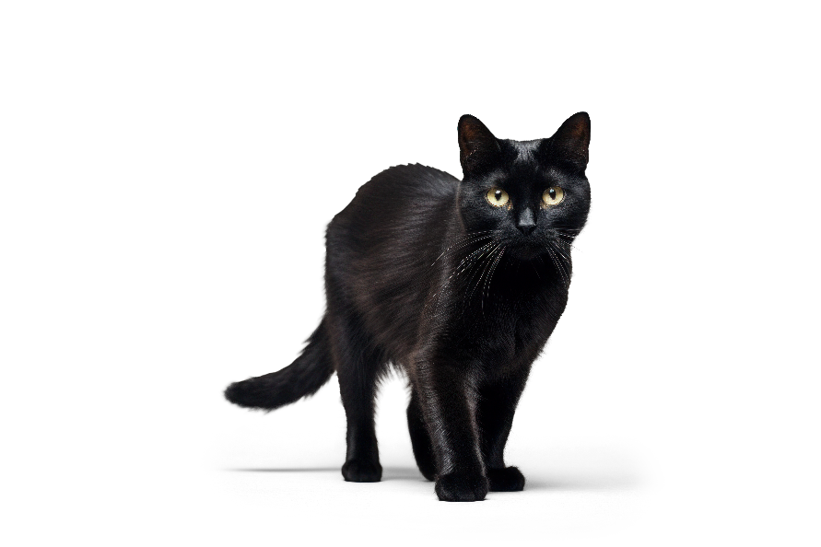



Superstitions
“We've always done it that way.”
Right way
Best practices
Notes:
A superstition is a belief not based on empirical evidence. While we may not consider ourselves superstitious, chances are there are many things that "we've always done it that way," or we heard someone else say it was the "right way." Software development is one of the most complicated practices in the world. There is no "one-size-fits-all" rule or best practice, it always depends on your situation. So how do you know you are doing it right?
This is a collection of questions, tools, principles, and techniques to challenge the way you develop with. It covers the entire software development process, including the way you write code, debugging, refactoring, testing, and tooling.

Slide 14

What is the best …
The question
I'm always asked

Slide 15
What is the best …
Component set
Database access framework
Grid component or library for …
Way to handle exceptions
LiveBindings vs Data Aware vs manual
Memory manager
OOP vs Procedural vs Functional
Database (NoSQL vs RDMBS)
Development methodology (SCRUM, Agile, etc.)
Programming language

Slide 16
Now you try
You need to loop through some TDataSet records. For each record you need to examine multiple fields:
What is best solution and why?
Fastest?
Uses least memory?
Easiest to maintain?
Simplest to explain?
How confident are you with your answer?
Possible Solutions:
FieldByName
FieldByNumber
Hard coded field names
Local references to each field
Custom SQL for each
Don't use TDataSet descendent
Switch to NoSQL from RDBMS
Something else….

Slide 17

It depends …
The answer is always

Slide 18
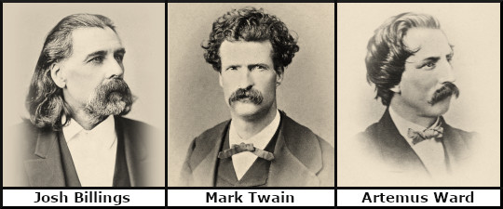
It ain’t what you don’t know
that gets you into trouble.
"
It’s what you know for sure
that just ain’t so.

Slide 19
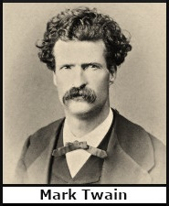
“The trouble with old men is they remember so many things that ain’t so.”

Slide 20

Unfounded confidence
gets us in trouble

Slide 21

Programming Changes
New versions of the Delphi compiler
Changes to the RTL
Different database access frameworks
Database backend changes
API changes
New versions of Windows
Different operating systems (Android, MacOS, Linux, etc.)
Multicore CPUs
New CPU instructions
We learn more

Slide 22
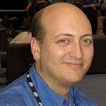
"Programming is an ART
that fights back."
-Chad "Kudzu" Howard

Slide 23
Dunning-Kruger Effect
“What’s the big deal?
This is so easy.
I already know it all!”
A cognitive bias
The less you know, the more you think you know
The more you learn, the more you realize there is to learn, and the less you really know
You can’t fill a cup that is already full
Hubris of
incompetence
on the
mountain
of ignorance.
Confidence
Cruelty
of Reality
“This is a harder
than I thought.”
Delusions of grandeur
“Wow, there is so
much to learn.”
Realistic
self-assessment
“I’m finally starting
to understand.”
After getting started
the easy stuff is easy.
Valley of
Humility
Novice
Average
Expert
Competence

Slide 24

Software Developer Levels
Junior Developer
Learning best practices
Intermediate Developer
Follows best practices
Senior Developer
Knows when to not follow best practices

Slide 25
Scientific Method or Engineering Process
Engineering brings a formal process
A very important step is to “test”
The results of the test provide the data
During planning it is important to set an expectation and define success
This is a cycle!
Use data to inform future solutions
The goals will change and evolve
Define Goal
Conceive Solution
Plan
Implement
Test
Improve
Start

Slide 26
Waterfall Model
Concept
Initiation
Analysis
Design
Construction
Testing
Deployment
Maintenance
A linier, non-cyclic model
Unrealistic
Requires all knowledge to exist at the beginning

Slide 27
Microscale Cyclic Process
External Requirement Goal
Conceive Solution
Write Code
Test & Collect Data
Improve
Even if the requirements are external
Still look at your own process as cyclic
Repeat the cycle until you meet the requirements
Use your data to meet future requirements better
Always test and collect data

Slide 28
The Math of Bugs and Fixes
Features
Bugs
Time
The source of bugs is writing code
Adding features produces bugs
Measure feature work as churn
Collect data on your team
How many bugs per unit of churn?
Keep testing and fixing until expected number of bugs found
Create
Require

Slide 29
Software Engineering
Time
Features
Bugs
It is a trade off between
Time, Features & Bugs
Given enough time all bugs are fixed
Shipping is also a feature
Reality is not all bugs will be found
What is the cost of shipping a bug

Slide 30
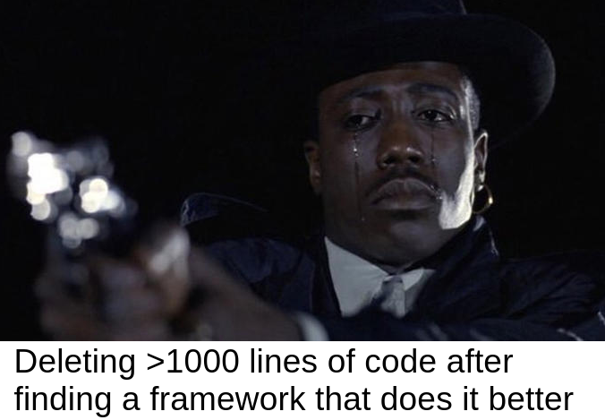
Think Outside The Box
Writing code isn't always the answer
Removed code doesn’t need to be maintained
Other options
Change system requirements
Update the environment
Use an external library
Change the back-end
Add hardware
What about a RAM drive?

Slide 31
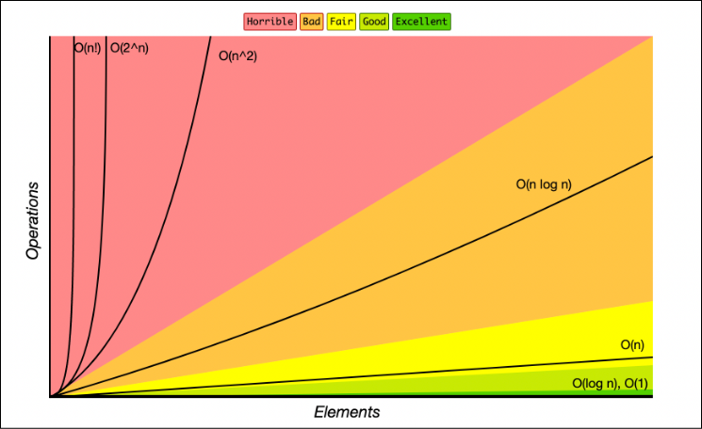
Big O Notation
Six types/levels of complexity
Constant: O(1)
Same time for any data size
Linear time: O(n)
Single loop
Logarithmic time: O(n log n)
Recursion
Quadratic time: O(n^2)
Nested loops
Exponential time: O(2^n)
Doubles with each item
Factorial time: O(n!)
GAH!
Measures worst-case time and space complexity based on input size
Useful to consider performance of different algorithms
freecodecamp.org/news/big-o-cheat-sheet-time-complexity-chart/
en.wikipedia.org/wiki/Big_O_notation
khanacademy.org/computing/computer-science/algorithms/asymptotic-notation/a/big-o-notation

Slide 32

Extremism
vs.
Pragmatism
Putting Theory into Practice

Slide 33
Different Types of Code
Application Code
Library Code
The majority of development
Applications that solve problems for end users
Very focused on productivity
Performance is less important
Underengineered
Used in applications
Focused on correctness, robustness, and reusability
Testing is more important than shipping
Performance is very important
Overengineered
Both still require good, clean code

Slide 34
The FizzBuzz Example
1
2
Fizz
4
Buzz
Fizz
7
8
Fizz
Buzz
11
Fizz
13
14
FizzBuzz
...
For numbers 1 through 100,
if the number is divisible by 3 print Fizz;
if the number is divisible by 5 print Buzz;
if the number is divisible by 3 and 5 (15) print FizzBuzz;
else, print the number.

Slide 35
FizzBuzz : Application Solution
1
2
Fizz
4
Buzz
Fizz
7
8
Fizz
Buzz
11
Fizz
13
14
FizzBuzz
...
procedure RunFizzBuzz;
begin
for var i := 1 to 100 do
begin
if (i mod 3 = 0) and (i mod 5 = 0) then
WriteLn('FizzBuzz')
else if i mod 3 = 0 then
WriteLn('Fizz')
else if i mod 5 = 0 then
WriteLn('Buzz')
else
WriteLn(i);
end;
end;

Slide 36
The “Enterprise” Solution
1
2
Fizz
4
Buzz
Fizz
7
8
Fizz
Buzz
11
Fizz
13
14
FizzBuzz
...
Heavy use of Factory pattern, Dependency Injection, and the Strategy pattern
Everything has an object, every object has an interface
A processor to handle the rules
Modularity to add or remove rules as needed
200+ line example in Delphi: github.com/jimmckeeth/FizzBuzzEnterpriseEdition-Delphi
This is a joke to illustrate a point.
See also:
github.com/jongeorge1/FizzBuzzEnterpriseEdition-CSharp 48 C# files, over 6 projects
github.com/EnterpriseQualityCoding/FizzBuzzEnterpriseEdition 89 Java files

Slide 37
So What?
1
2
Fizz
4
Buzz
Fizz
7
8
Fizz
Buzz
11
Fizz
13
14
FizzBuzz
...
Most of the time we are writing application code
Don’t over engineer it
Avoid premature optimization
Use safeguards
Still write clean code
Still use tests and best practices
Get it done and ship the application

Slide 38
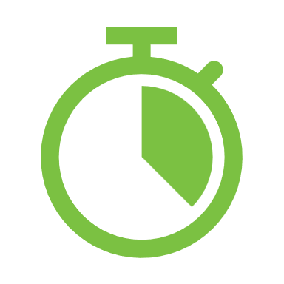
Premature Optimization
Avoid it
Without data any optimization:
May be counter productive
Produce little impact
Not worth the effort
Don’t waste your time, profile first

Slide 39

Tools
Profilers
Unit Testing
Code Coverage
Static Code Analysis
Logging
What other tools give you evidence?

Slide 40
Profilers
delphitools.info/samplingprofiler
prodelphi.de
smartbear.com/product/aqtime-pro
yavfast.github.io/dbg-spider
github.com/ase379/gpprofile2017
CPU Specific
Intel Vtune + map2pdb
AMD μProf
Apple Instruments
List of Performance Analysis Tools
See what code is spending the most time, both per execution, and total number of executions
Find out where to optimize
Focus on slowest code with most executions and impacting most users
The xz Utils backdoor was discovered via micro-benchmarking

Slide 41
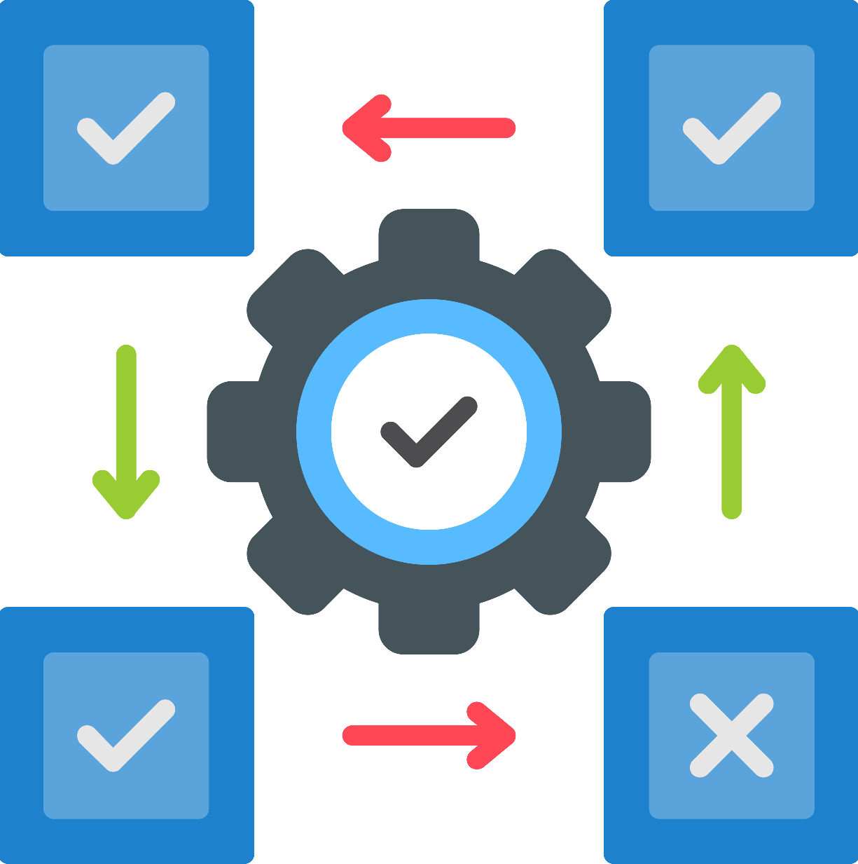
Unit Testing
Dunit docwiki/RADStudio/en/DUnit_Overview
DunitX 👈 github.com/VSoftTechnologies/DUnitX
TestInsight 👈 bitbucket.org/sglienke/testinsight/wiki

Slide 42

Logging
Logging
raize.com/codesite with Method Tracer!
code-partners.com/offerings/smartinspect
github.com/grijjy/GrijjyCloudLogger
madexcept.com
eurekalog.com

Slide 43

Code Coverage
github.com/DelphiCodeCoverage/DelphiCodeCoverage
github.com/MHumm/delphi-code-coverage-wizard-plus
sourceforge.net/projects/discoverd/
AQTime
SmartInspect
CodeInsite

Slide 44

Static Code Analysis
www.tmssoftware.com/site/fixinsight.asp
github.com/Embarcadero/SonarDelphi
peganza.com Pascal Analyzer & Pascal Expert
derscanner.com
DIY
github.com/RomanYankovsky/DelphiAST
Outdated
github.com/SourceMonitor/SM-Info
socksoftware.com/codehealer.php
github.com/MikhailIzvekov/DelphiSCA

Slide 45
FINALIZATION
Don’t believe what you “know”
Test
Collect data
Use the source & tools
github.com/jimmckeeth/Evidence-Based-Software-Engineering
jim@gdksoftware.com

Slide 46
END.
github.com/jimmckeeth/Evidence-Based-Software-Engineering
jim@gdksoftware.com

